Slide 1


Shaik Samiulla
July 2024

Slide 2

Outline
Executive Summary
Introduction
Methodology
Results
Conclusion
Appendix

Slide 3
Executive Summary
The SpaceX data was collected through using the SpaceX API and through webscraping of the spaceX wikipedia page. The data was then wrangled and Exploratory Data Analysis was performed using SQL queries and data visualisation (plotting seaborne graphs). Interactive visual analytics were created using Folium and Plotly Dash and helped collect insights on the dataset. Finally, predictive classification models were tested. Different classification models (Support Vector Machines (SVM), Classification Trees, and Logistic Regression) were built using the training set and tested using the test set.
The best performing methods are logistic regression, support vector machine and k-nearest neighbours. They all have the same confusion matrix and the same accuracy score of 0.8333333333333334.

Slide 4
Introduction
In this capstone project, our objective is to predict whether the Falcon 9 first stage will land successfully. The advertised price of a Falcon 9 rocket launch (on Space X's website) is 62 million US dollars each whereas other providers advertise costs upwards of 165 million US dollars. The difference in price can be explained by the fact SpaceX reuses the first stage of their rocket launch. Therefore if we can determine if the first stage will land, we can determine the cost of a launch. This information can be used if an alternate company wants to bid against SpaceX for a rocket launch. This project involves data science techniques such as data analysis, data visualization, and machine learning by using Python.
The project is split into 4 parts, where the data is first collected through webscraping and focus is given on understanding the dataset. The data is then wrangled in Python. Exploratory Data Analysis is performed using SQL and using Pandas and Matplotlib in Python). Interactive visual analytics were then created using FoliumBuild and an interactive dashboard was created in Plotly Dash. Finally, predictive classification models were tested and validated in python. The data driven insights will be presented in this report.

Slide 5

Section 1

Slide 6
Methodology
Executive Summary
Data collection methodology:
SpaceX launch data was collected with the SpaceX REST API (Application programming interface). A python code was then written to convert a JSON file and manipulate data in a Pandas data frame.
Data was also sourced from the SpaceX Wikipedia page via webscraping, using the BeautifulSoup python package.
Perform data wrangling
The data was parsed into a pandas dataframe and cleaned up to contain only information useful to this study. Data was wrangled by creating calculations and determining useful training labels.

Slide 7
Methodology
Executive Summary
Exploratory data analysis (EDA) using visualization and SQL:
The dataset was queried and explored using SQL methods and seaborn visual plots.
Interactive visual analytics using Folium and Plotly Dash:
An interactive folium map was created to geographically query and visualise the launch data.
An interactive plotly dash app was created to interactively slice and plot the data (scatter and pie charts).
Predictive analysis using classification models:
The dataset was standardised then split into training and testing datasets.
Different classification models (Support Vector Machines (SVM), Classification Trees, and Logistic Regression) were built using the training set. The models were tuned by performing a grid search to find the hyperparameters that allow a given algorithm to perform best. The models were then evaluated by using confusion matrices and calculating accuracies on the test set. The models that performed best had the highest accuracy values.

Slide 8
Data Collection Summary
SpaceX API: SpaceX launch data was collected with the SpaceX REST API. A GET request was used to request and parse the SpaceX launch data. The response content Json was decoded using .json() and turned it into a Pandas dataframe using .json_normalize(). The SpaceX API allows us to gather data about launches, including information about the rocket used, payload delivered, launch specifications, landing specifications, and landing outcome.
Web scraping: Falcon 9 launch records saved in HTML tables available on the SpaceX Wikipedia page were webscraped using the BeautifulSoup python library. The table was then parsed and converted into a pandas data frame.

Slide 9
Data Collection – SpaceX API
Steps required for data collection through SpaceX API:
Get request: request data from SpaceX API
Decode response: using json() function
Request information: request further information aboutusing columns rocket, payloads, launchpad, and cores. using API
Create dictionary: combine the collected columns into a dictionary.
Create dataframe: using .json_normalize()
Filter dataframe: to contain only information about Flacon 9 launches
Replace null values: replace missing payload mass with mean value
Export data to a .csv
GitHub URL of the completed SpaceX API calls notebook:
https://github.com/JustAGeologist/Data-Science-and-Machine-Learning-Capstone-Project/blob/8d91215fdc224ed58b2b41aa6030ec51e00689d3/jupyter-labs-spacex-data-collection-api.ipynb
Get request
Decode response
Request information
Filter dataframe
Create dataframe
Create dictionary
Replace null values
Export data to .csv

Slide 10
Data Collection - Scraping
Steps required for webscraping:
HTTP GET method: to request the Falcon9 Launch HTML page, as an HTTP response.
Create a BeautifulSoup object from a response text content
Extract all column/variable names from the HTML table header
Create a data frame by parsing the launch HTML tables
We will create an empty dictionary with keys from the extracted column names in the previous task.
Later, this dictionary will be converted into a Pandas dataframe
Present your web scraping process using key phrases and flowcharts
GitHub URL: https://github.com/JustAGeologist/Data-Science-and-Machine-Learning-Capstone-Project/blob/f36928df0ed8158594e53ac3b3e2e5a45ab5f4b7/2-jupyter-labs-webscraping.ipynb
HTTP get request
Create BeautifulSoup object
Create dictionary
Extract information from html tables
Create dataframe
Export data to .csv

Slide 11
Data Wrangling
Data wrangling steps:
Calculate the number of launches on each site
Calculate the number and occurrence of each orbit
Calculate the number and occurence of mission outcome per orbit type
Create a landing outcome label from Outcome column (convert those outcomes into Training Labels with 1 means the booster successfully landed 0 means it was unsuccessful)
Calculate success rate of landing
Export data to .csv file
GitHub URL: https://github.com/JustAGeologist/Data-Science-and-Machine-Learning-Capstone-Project/blob/62b6a2f3ab61aa2ce33029a7802603fcfd423347/3-labs-jupyter-spacex-data_wrangling_jupyterlite.jupyterlite.ipynb
EDA and calculations
Determine training labels
Export data to .csv
Calculate success rates of landing

Slide 12
EDA with Data Visualization
A variety of seaborne charts were plotted in this part of the study: categorical plots (catplots), barplots, scatter plots, and line plots)
Categorical scatter plots: to visualize the relationship between Flight Number and Launch Site and the relationship between Payload and Launch Site
Bar plot: to visualize the relationship between success rate of each orbit type
Categorical scatter plot: to visualize the relationship between Payload and Orbit type
Line plot: to visualize the launch success yearly trend. It represents a trend over time.
GitHub URL: https://github.com/JustAGeologist/Data-Science-and-Machine-Learning-Capstone-Project/blob/ccc36bd5ba3172b10bf8875dbdada9275ba2d762/5-jupyter-labs-eda-dataviz.ipynb.jupyterlite.ipynb

Slide 13
EDA with SQL
Steps required:
Load the SQL extension and connect to the @my_data1.db database
Remove blank rows from table
Display the names of the unique launch sites in the space mission using the DISTINCT function and the total payload mass carried by boosters launched by NASA (CRS) by using the SUM function. The average payload mass carried by booster version F9 v1.1 by was also displayed using the AVG function.
List the date where the succesful landing outcome in drone ship was achieved.using the min() function on date
List the names of the boosters which have success in ground pad and have payload mass greater than 4000 but less than 6000
List the total number of successful and failure mission outcomes
List the names of the booster_versions which have carried the maximum payload mass using a subquery
List the records which will display the month names, succesful landing_outcomes in ground pad ,booster versions, launch_site for the months in year 2017. SQLLite does not support monthnames. So we used substr(Date,6,2) for month, substr(Date,9,2) for date, substr(Date,0,5),='2017' for year.
Rank the count of landing outcomes (such as Failure (drone ship) or Success (ground pad)) between the date 2010-06-04 and 2017-03-20, in descending order
GitHub URL: https://github.com/JustAGeologist/Data-Science-and-Machine-Learning-Capstone-Project/blob/30a66ad3f1050a49fe8a4518d239bfa5bcdc1d6d/4-jupyter-labs-eda-sql-edx_sqllite.ipynb

Slide 14
Build an Interactive Map with Folium
Step required to create Folium Map output:
Mark all launch sites with a circle and label on a map to make them easily visible. Depending on the proximity of launch sites, markers may be clustered.
Mark the success/failed launches for each site on the map using colour coded circle markers.
Calculate the distances between a launch site to its proximities. Lines were drawn and distances were maked on the map to easily assess the distance between launch sites and proximal locations (cities, coasts, highways, railways) to determine some geographical patterns about launch sites.
The map is interactive and allows the user to zoom in and out as well as get coordinates from mouse locations.
GitHub URL: https://github.com/JustAGeologist/Data-Science-and-Machine-Learning-Capstone-Project/blob/0957acd5bfa16c94808385813303ad82e1645dfc/6-lab_jupyter_launch_site_location.jupyterlite.ipynb

Slide 15
Build a Dashboard with Plotly Dash
An interactive dashboard was created using Plotly Dash
An interactive dropdown list allows the dashboard user to select a specific site or all sites, which refreshes the data in the pie chart below.
A pie chart was plotted showing the total success launches by site
A categorical scatter plot was created to illustrate the between payload mass and success rate for different booster versions. The payload mass range can be selected by the user using an interactive scale bar. It refreshes the data in the scatter plot.
GitHub URL: https://github.com/JustAGeologist/Data-Science-and-Machine-Learning-Capstone-Project/blob/3af1c88077f02006291bfdc3ea69bf1231a213f6/7-spacex_dash_app.py

Slide 16
Predictive Analysis (Classification)
Steps required:
Dataset was standardised then split into training and testing sets
Different classification models (Support Vector Machines (SVM), Classification Trees, and Logistic Regression) were built using the training set. The models were tuned by performing a grid search to find the hyperparameters that allow a given algorithm to perform best.
The models were then evaluated by using confusion matrices and calculating accuracies on the test set. The models that performed best had the highest accuracy values.
GitHub URL: https://github.com/JustAGeologist/Data-Science-and-Machine-Learning-Capstone-Project/blob/30dc6df849cb4b2a365195cb4ae9f234ee67a8f2/8-SpaceX_Machine_Learning_Prediction_Part_5.jupyterlite.ipynb
EDA
Determine training labels
Create column for class
Train models
Split into training and test data
Standardise data
Find best hyperparameters
Determine best performing method

Slide 17
Results
Exploratory data analysis results
Interactive analytics demo in screenshots
Predictive analysis results

Slide 18

Section 2

Slide 19
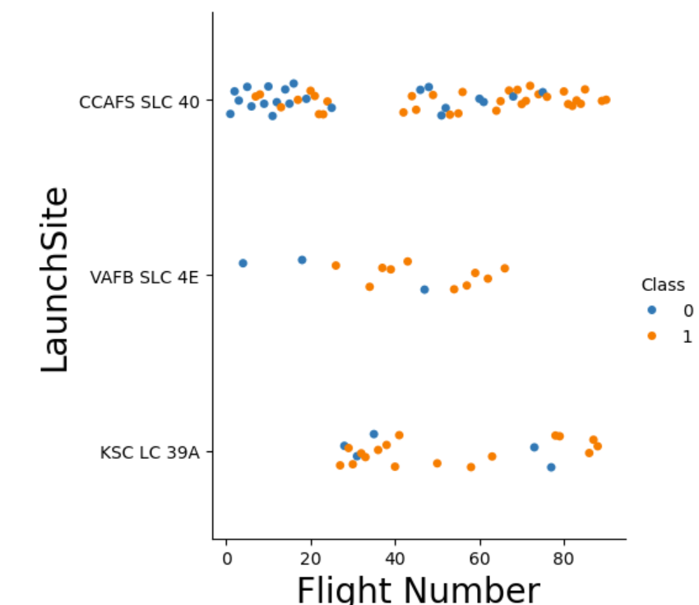
Flight Number vs. Launch Site
This categorical scatter plot suggests that launch site CCAFS SLC 40 was most used (highest number of points).
With an increasing flight number, the class evolves from 0 (failed launches, in blue) to a higher frequency of 1 values (successful launches, in yellow)

Slide 20
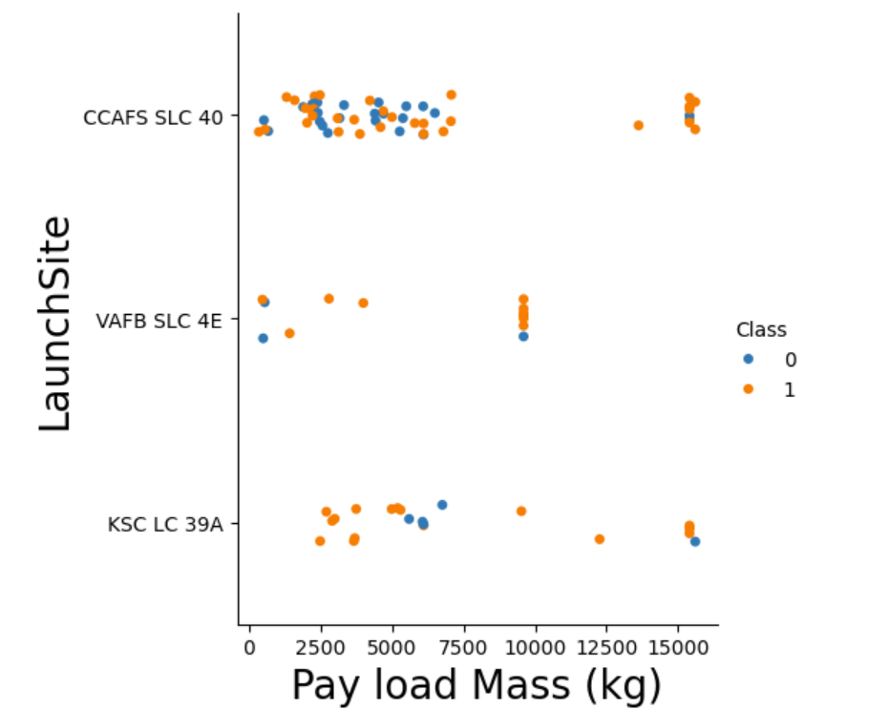
Payload vs. Launch Site
The scatter plot of Payload vs. Launch Site shows that with higher payload masses (7500 kg), the launches have a higher chance of being successful (class 1).
Launch site VAFB SLC 4E has not launched a payload greater than 10 000 kg.

Slide 21
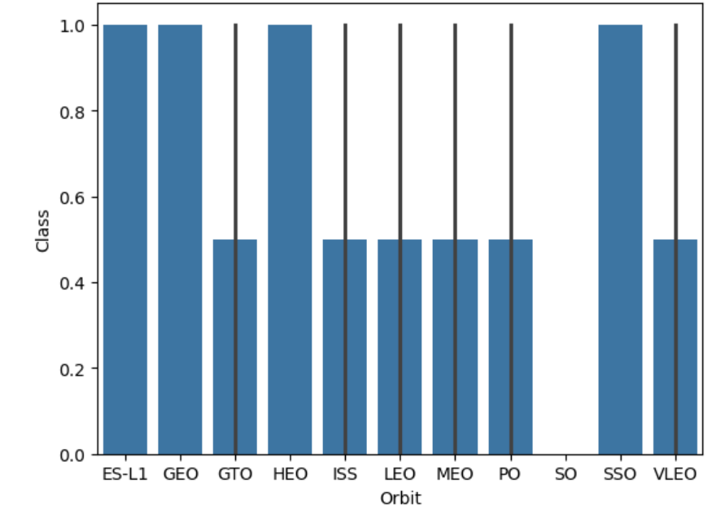
Success Rate vs. Orbit Type
The bar chart for the success rate of each orbit type shows that orbit types ES-L1, GEO, HEO and SSO have a 100% success rate (Class 1) whereas orbit types GTO, ISS, LEO, MEO, PO and VLEO have success rate of 50%.
Orbit type SO has a 0% success rate.

Slide 22
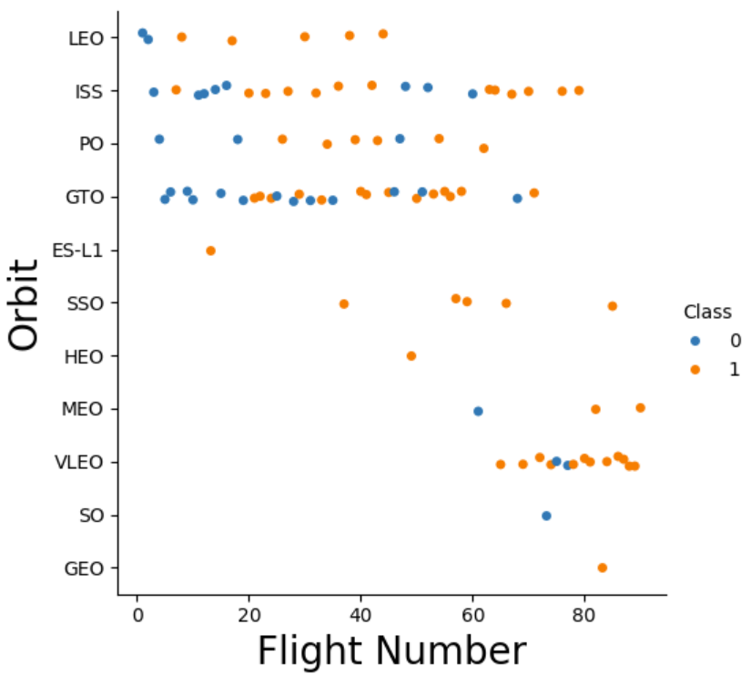
Flight Number vs. Orbit Type
A number of observations can be drawn from the scatter point of Flight number vs. Orbit type:
Although Orbits ES-L1, SSO, and GEO have very low number of launches, they have a 100% success rate (class 1)
Orbits ISSandPO have a higher number of launches and with an increasing flight number, their success rate has increased
Although orbit GTO has a high number of launches, the results are mixed (moderate success rate)
Only one launch was performed in Orbit SO and it failed (class 0).

Slide 23
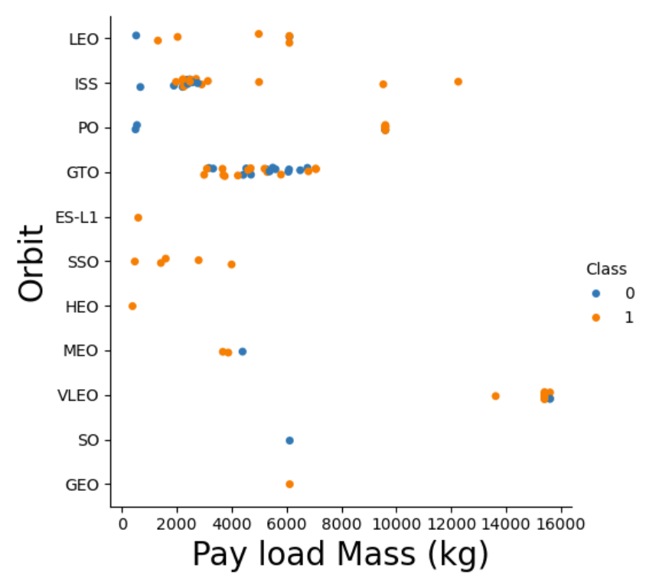
Payload vs. Orbit Type
A number of observations can be made from the scatter point of payload vs. orbit type:
The higher the payload mass, the lower the number of launches.
The launches performed with higher payload masses (>8000 kg) are generally successful.
The launches performed in orbit SSO, HEO and ES-L1 have been carried out with low payload masses and have been 100% successful.
The launches in orbit GTO show mixed results (successes and fails regardless of the difference in payload mass)
Launches in orbits LEO, PO and ISS show that launches with higher payload masses are more successful than with lighter payload masses.

Slide 24
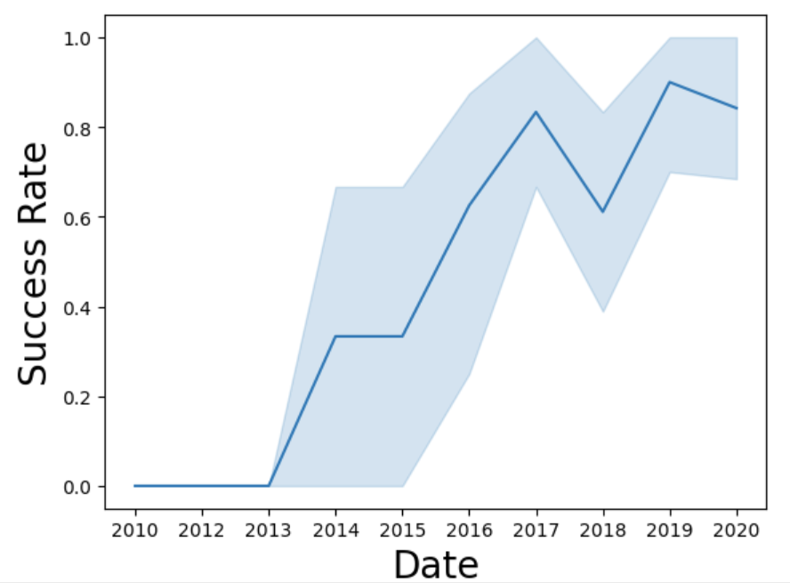
Launch Success Yearly Trend
The line chart of yearly average success rate clearly shows an increase in success rate as the years go by, with the exception for 2018 where a significant drop in success rate occurred.

Slide 25
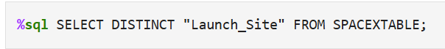
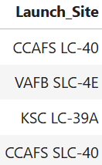
All Launch Site Names
The names of the unique launch sites were identified using the DISTINCT function in the SQL query pasted below:
The distinct launch site names are presented in the table below:

Slide 26
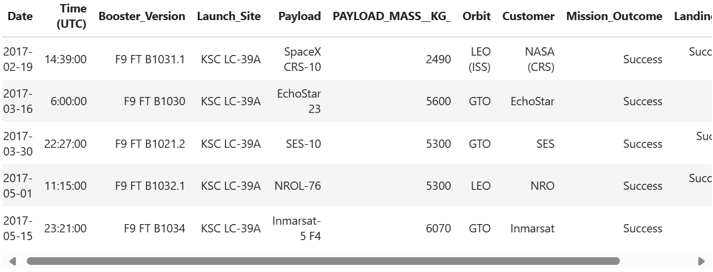
Launch Site Names Begin with 'KSC'
The query below was used to find 5 records where launch sites’ names start with `KSC`. The like function allows to find names that start with KSC. The LIMIT function limits the selection to the first 5 names.
The outcome of the query is pasted below:

Slide 27
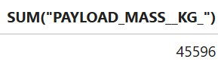
Total Payload Mass
The total payload carried by boosters from NASA was calculated using the SUM function in SQL:
The outcome of the query is pasted below:

Slide 28
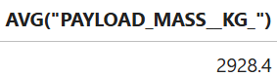
Average Payload Mass by F9 v1.1
The average payload mass carried by booster version F9 v1.1 was calculated using the AVG function:
The outcome of the query is pasted below:

Slide 29
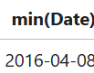
First Successful drone ship Landing Date
The dates of the first successful landing outcome on drone ship were extracted from the query below. The min function was used on the Date column:
.The date is:

Slide 30
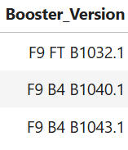
Successful Ground Pad Landing with Payload between 4000 and 6000
The names of boosters which have successfully landed on a ground pad and had payload mass greater than 4000 but less than 6000 were listed using the following query:
%sql SELECT "Booster_Version" FROM SPACEXTBL WHERE "Landing_Outcome" = "Success (ground pad)" AND "PAYLOAD_MASS__KG_" > 4000 AND "PAYLOAD_MASS__KG_" < 6000;
The outcome of the query is summarised in the table below:

Slide 31
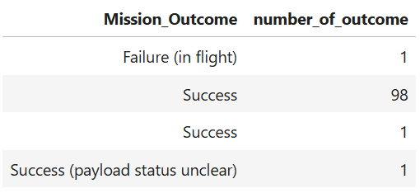
Total Number of Successful and Failure Mission Outcomes
The total number of successful and failure mission outcomes were calculated using this query: %sql SELECT Mission_Outcome, COUNT(Mission_Outcome) AS number_of_outcome FROM SPACEXTBL GROUP BY Mission_Outcome;
Only one mission failed in flight whereas all other missions were successful.

Slide 32
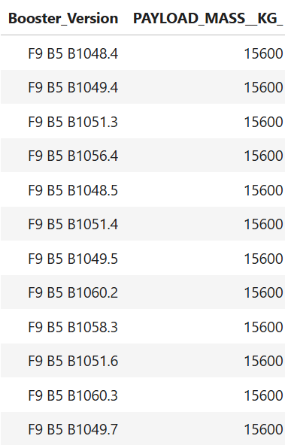
Boosters Carried Maximum Payload
The names of the booster which have carried the maximum payload mass were found using the following query: %sql SELECT Booster_Version, "PAYLOAD_MASS__KG_" FROM SPACEXTBL WHERE "PAYLOAD_MASS__KG_" = (SELECT max("PAYLOAD_MASS__KG_") FROM SPACEXTBL);
The outcome of the query is summarised in the table:

Slide 33
2017 Launch Records
The month names, succesful landing_outcomes in ground pad ,booster versions, launch_site for the months in year 2017 records were extracted using the following query: %sql SELECT substr(Date, 6, 2) AS month, "Landing_Outcome", "Booster_Version", "Launch_Site" FROM SPACEXTBL WHERE substr(Date,0,5)="2017" AND "Landing _Outcome" IN ("Success (ground pad)");
Note: SQLLite does not support monthnames. So you need to use substr(Date,6,2) for month, substr(Date,9,2) for date, substr(Date,0,5),='2017' for year.

Slide 34
Rank Landing Outcomes Between 2010-06-04 and 2017-03-20
The following query was used to rank the count of landing outcomes (such as Failure (drone ship) or Success (ground pad)) between the date 2010-06-04 and 2017-03-20, in descending order: %sql SELECT * FROM SPACEXTBL WHERE "Landing_Outcome" = "Success (ground pad)" OR "Landing_Outcome" = "Failure (drone ship)" AND ("Date" BETWEEN '2010-06-04' AND '2017-03-20') ORDER BY "Date" DESC;
The output of the query is summarised in the table in the next slide. Please note that the entire table could not fit in one page, please refer to GitHub link to see the full table: https://github.com/JustAGeologist/Data-Science-and-Machine-Learning-Capstone-Project/blob/30dc6df849cb4b2a365195cb4ae9f234ee67a8f2/4-jupyter-labs-eda-sql-edx_sqllite.ipynb

Slide 35
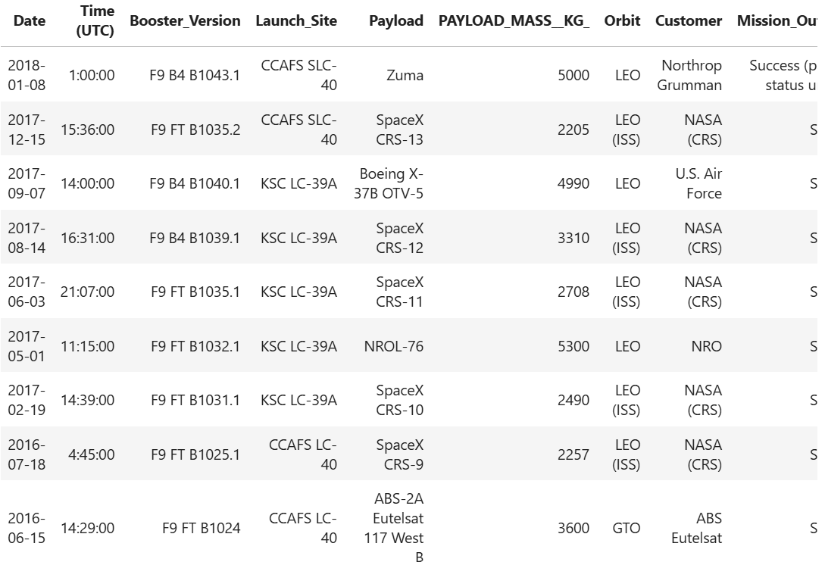
Rank Landing Outcomes Between 2010-06-04 and 2017-03-20
The output of the query is summarised in the table::

Slide 36

Section 3

Slide 37
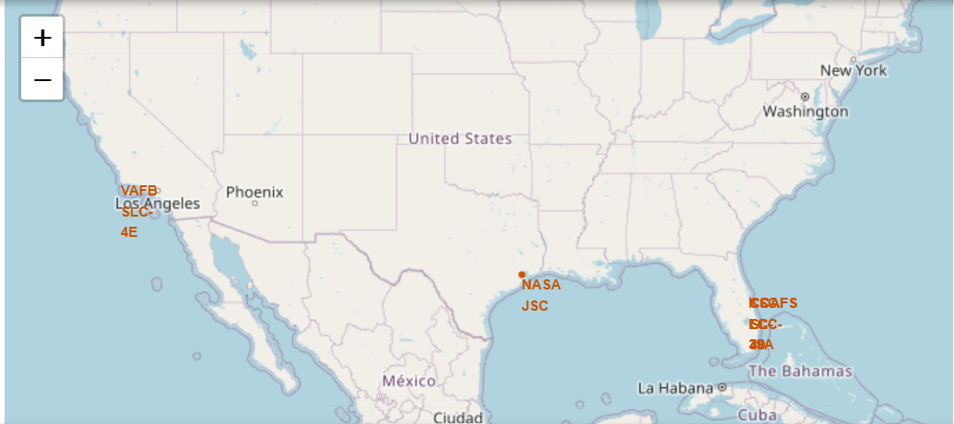
Map of all launch sites
The interactive folium map includes all launch sites’ location markers.
All launch sites seem to be in coastal areas the southern part of the US, close to the cancer tropic line.

Slide 38
<Folium Map Screenshot 2>
Replace <Folium map screenshot 2> title with an appropriate title
Explore the folium map and make a proper screenshot to show the color-labeled launch outcomes on the map
Explain the important elements and findings on the screenshot

Slide 39
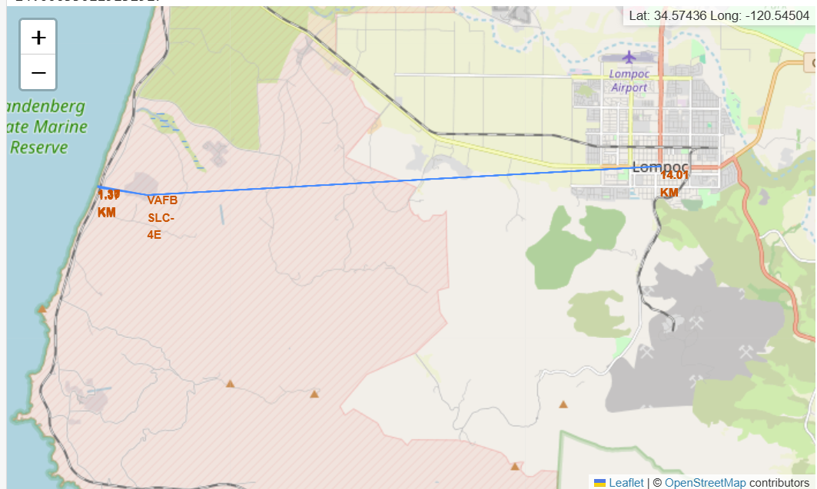
Map of proximity of launch site to the coast, city and highway
Launch site VAFB SLC 4E is 1.39km from the highway and the coast, and 14.01km away from the nearest city
The location is strategic for testing of rocket launches but also allows for supply of parts and workforce.

Slide 40

Section 4

Slide 41
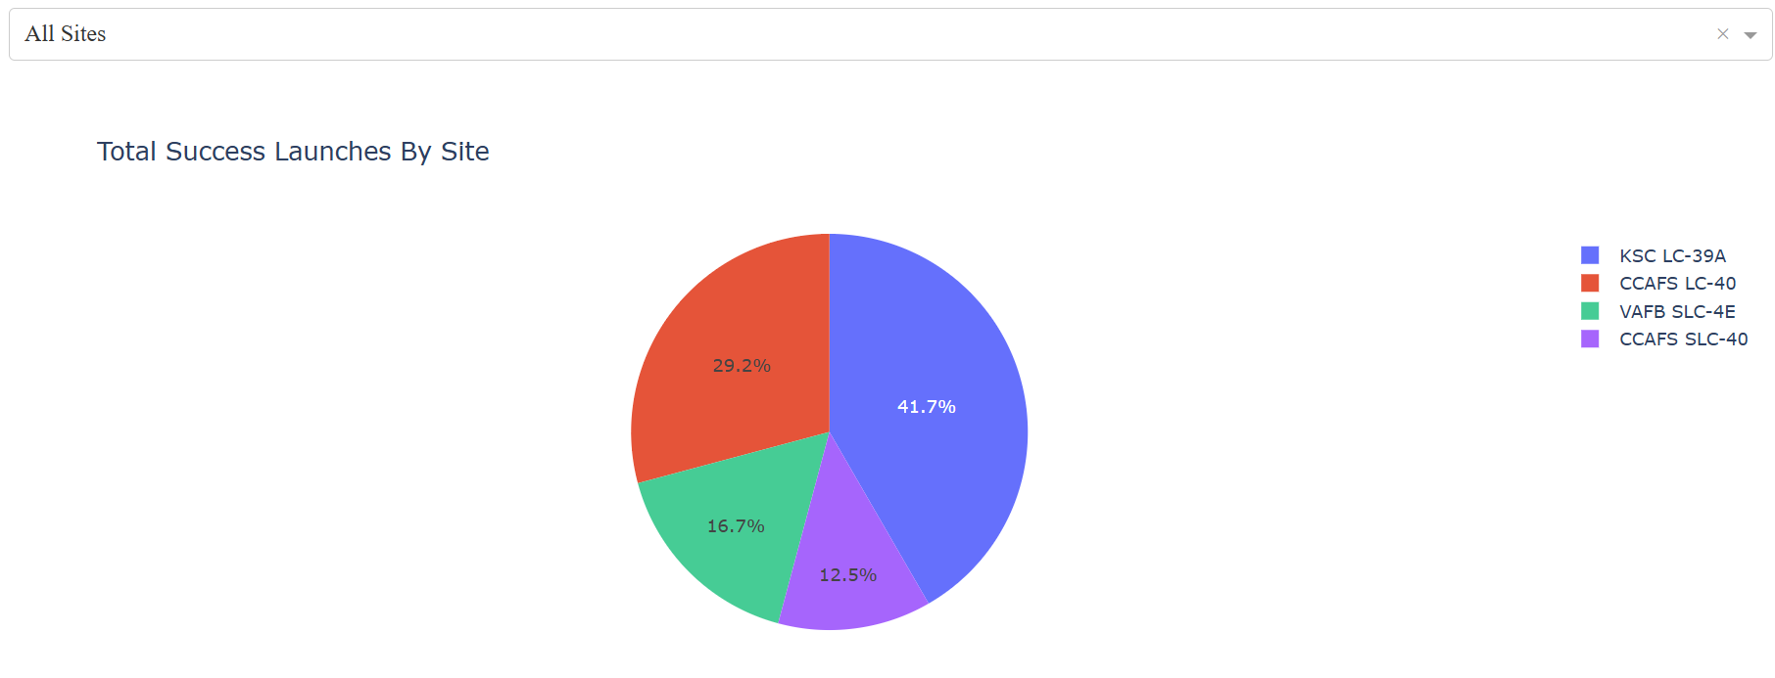
Piechart of launch succes counts for all sites
Most (41.7%) successful launches have been launched from launch site KSC-LC-39A. The smallest proportion of successful launches were launched from CCAFS SLC 40.

Slide 42
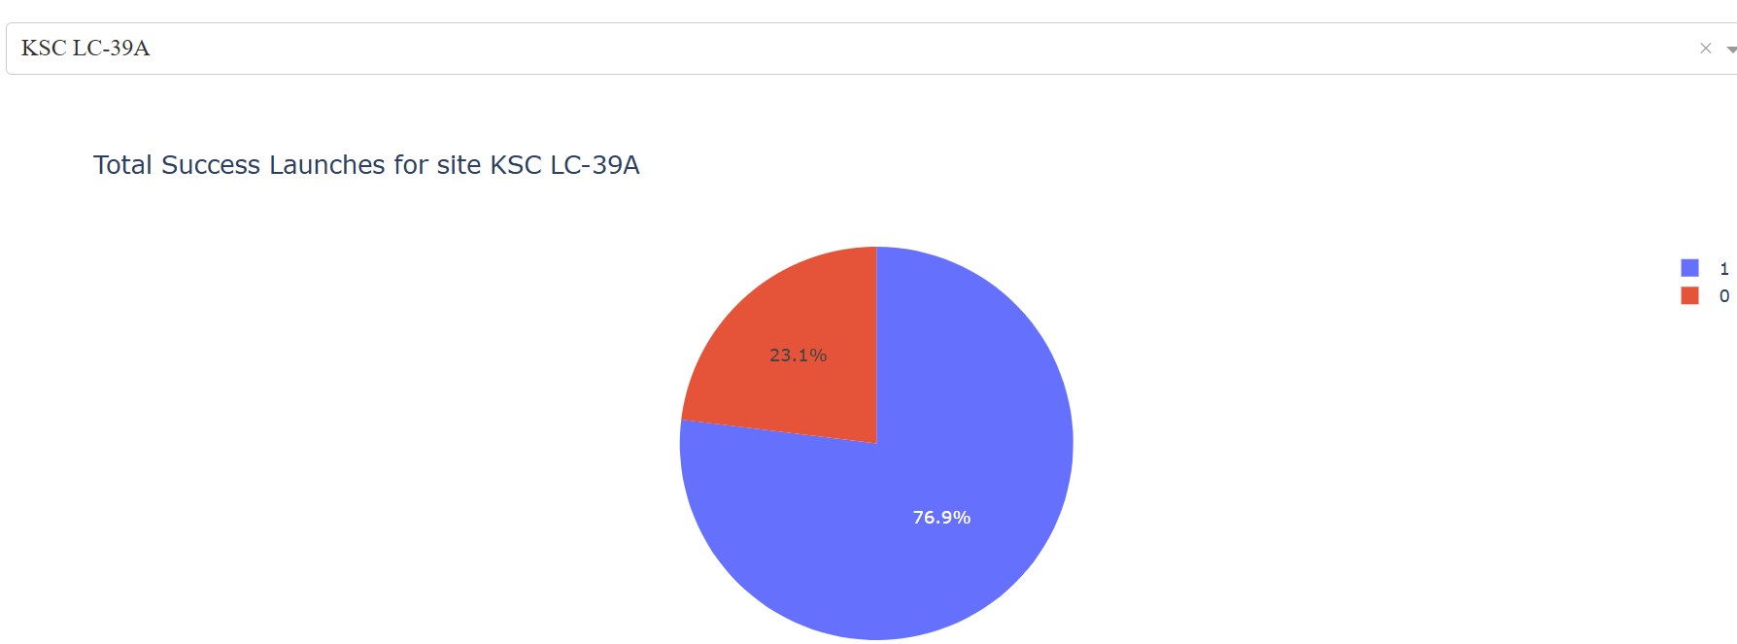
Piechart for launch site KSC LC 39A
KSC LC 39A is the launch site with highest launch success ratio (1= success and 0=fail)

Slide 43
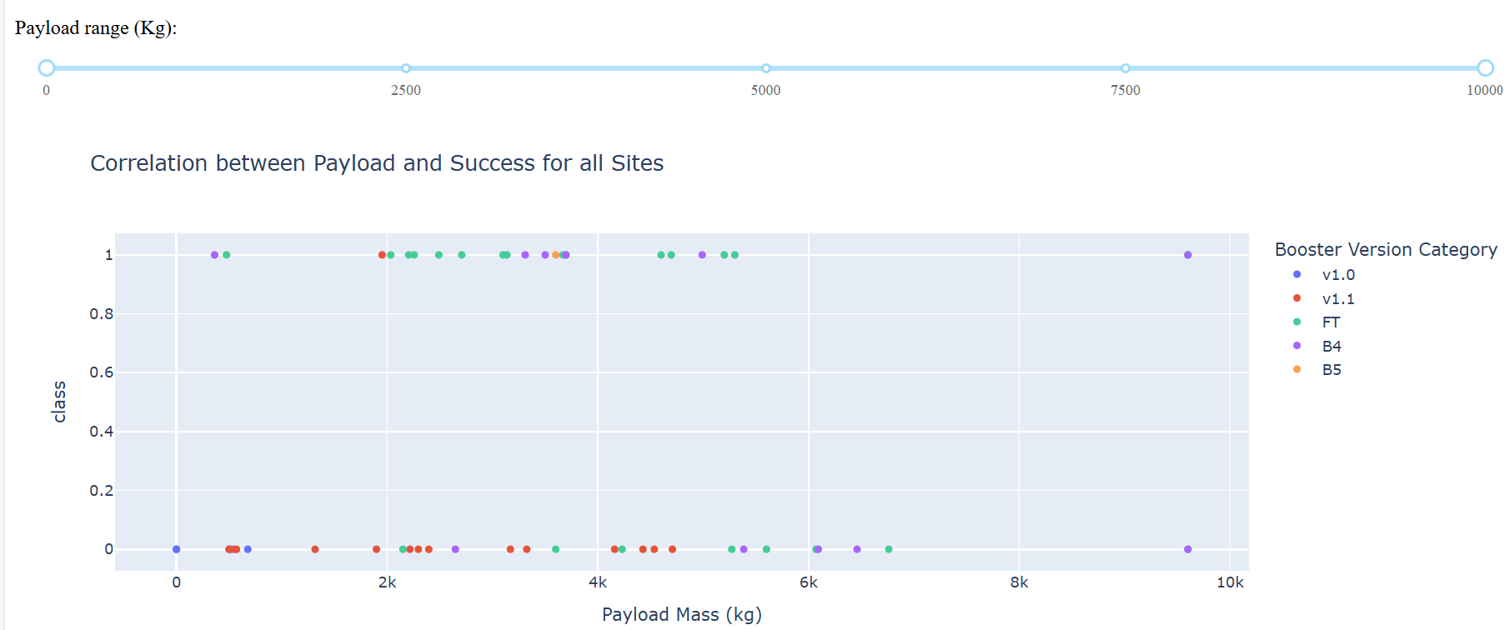
Payload vs Launch Outcome scatter plot for all sites with payload range slider
The payload range between 2000 kg and 4000 kg has the highest success rate (class=1 is success).
FT booster versions have the highest success rate.

Slide 44

Section 5

Slide 45
Classification Accuracy
Visualize the built model accuracy for all built classification models, in a bar chart
Find which model has the highest classification accuracy

Slide 46
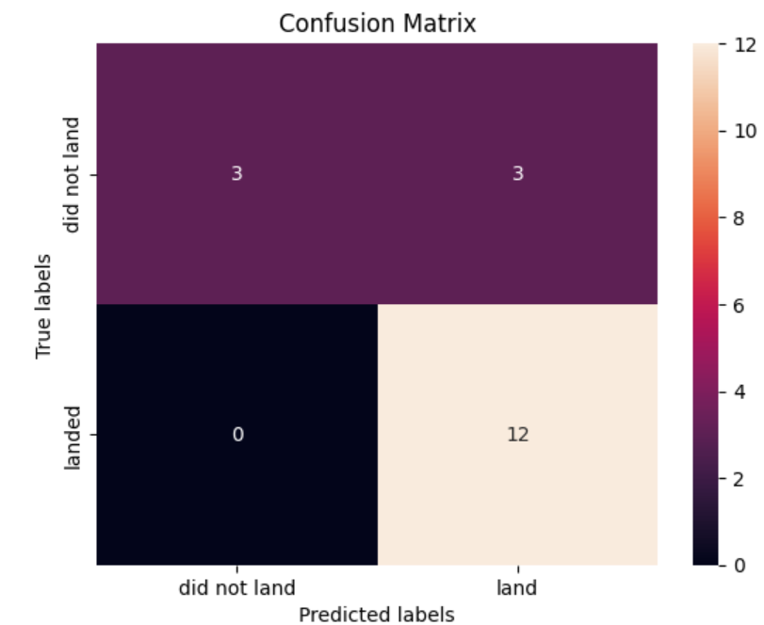
Confusion Matrix
The best performing methods are logistic regression, support vector machine and k-nearest neighbours. They all have the same confusion matrix and the same accuracy score of 0.8333333333333334.

Slide 47
Conclusions
The best performing methods are logistic regression, support vector machine and k-nearest neighbours. They all have the same confusion matrix and the same accuracy score of 0.8333333333333334.

Slide 48


